Slide 1
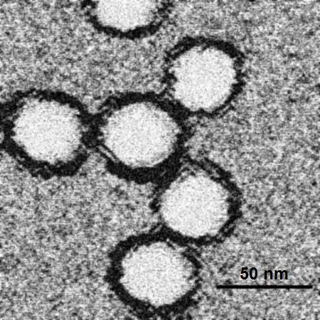
West Nile virus prediction
Daniel Nahmias

Slide 2
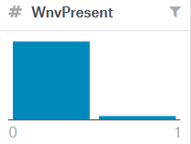
Preliminary analysis
Data is imbalanced – AUC score is needed.
Spray data is extremely lacking on test set dates.
Weather data is dirty and a little missing, some preprocessing is needed.
It is common knowledge that mosquitos tend to populate hot and humid places.
Number of mosquitos is capped at 50 per row.
“Number of mosquitos” column is missing from the test set.

Slide 3
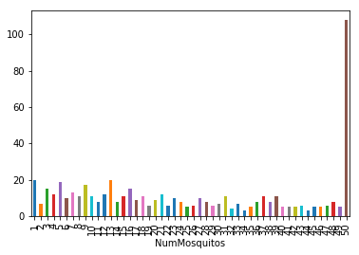

Slide 4
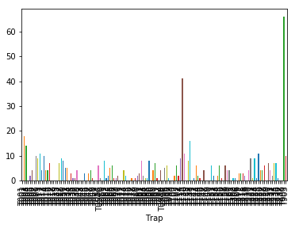
Trap #

Slide 5
We can’t use “Number of mosquitos” explicitly, that doesn’t mean we cant use it at all.
Added “Mosquitos rate per trap” feature.
Added “WNV rate per trap” feature.
We can also predict the explicit values using regression models.

Slide 6
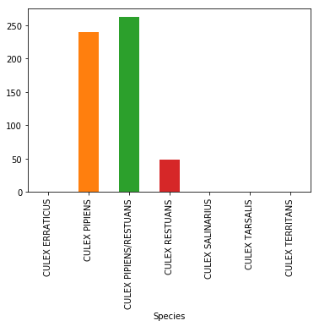
West Nile virus is primarily transmitted by mosquitoes, mostly species of the genus Culex. - Wikipedia

Slide 7
Weather data
Weather data should provide valuable info.
Data is available from 2 weather stations at different locations.
After experimentation, appending weather data from both stations and their distance (haversine distance) produced the best results.

Slide 8
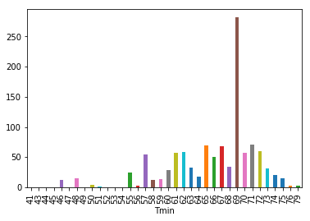

Slide 9
Weather data cleaning
Features with more than 1000 missing values (per station) were imputed.
The rest of the missing values were forward filled (due to weather behavior).

Slide 10
Temporal features
In order to add seasonality information to the dataset, the following features were engineered:
Month of the year
Week of the year
Day of the year
These features were engineered due to the fact that both mosquitos and birds have a seasonal movement pattern.

Slide 11
Models
After few experimentations, the model that produced the best result was Sklearn’s Gradient Boosting Classifier (default parameters).
The other models that were tested were: Random Forest, AdaBoost and CatBoost which produced similar but inferior results.

Slide 12
Kaggle score
Private: 0.70352
Public: 0.74003

Slide 13
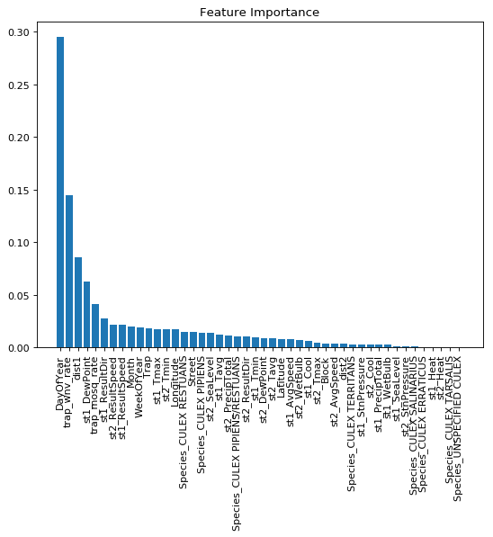

Slide 14
Discussion
From our model’s results, we can infer that the following criteria should be considered for deciding where to spray:
WNV presence is seasonal. Therefore, the day of the year feature holds valuable information.
Traps with high observed WNV presence rate are strong indicators of areas that are likely to suffer from WNV presence in a given date.
Nygren, David, et al. "Remotely-sensed, nocturnal, dew point correlates with malaria transmission in Southern Province, Zambia: a time-series study." Malaria journal 13.1 (2014): 231.

Slide 15
Impact
Cases of hospitalized WNV disease are estimated to cost an average of $56 million per year in disease-associated morbidity and mortality. (.E. Staples, M.B. Shankar, J.J. Sejvar, M.I. Meltzer, M. Fischer - Initial and long-term costs of patients hospitalized with West Nile virus disease - Am J Trop Med Hyg, 90 (3) (2014), pp. 402-409)
Total cost of the 2005 Sacramento County WNV epidemic was ≈$2,979,037. Costs for treating WNND patients alone exceeded costs of emergency vector control by $1,438,619, a ratio of 3:1. This difference suggests that for the benefits of the vector control to outweigh the cost of the epidemic, the spray event would need to prevent only 15 WNND cases. (Economic Cost Analysis of West Nile Virus Outbreak, Sacramento County, California, USA, 2005 Loren M. Barber, Jerome J. Schleier, and Robert K.D. Peterson)

Slide 16

Limitations
A lot of temporal information is ignored in this model. Engineering temporal features manually proved to be useless over time.
Results might improve by using multivariate time series and sequence mining models (KarmaLego, Multivariate LSTMs)
Spray data was completely ignored.

Slide 17
Future data collection
WNV originates from birds and propagates through mosquitos. It might be useful if Chicago’s sanitation workers can report findings of dead birds.
West Nile Virus Reported in Chicago, But Don’t Blame Mosquitoes
A more complete spray data might provide more useful information.

